Slide 1

2EC602 Machine Learning
Diagnosing Autism Spectrum Disorder
using Machine Learning
20BEC108 | Sanchit Sharma

Slide 2

Introduction
Literature Review
Data Preprocessing
Modelling
Hyperparameter tuning
Result and analysis
Conclusion and Future work

Slide 3
Autism Spectrum Disorder (ASD) is a developmental disorder that impairs communication, social skills and cognitive abilities. Diagnosing ASD is challenging due to the varying symptoms. Machine learning techniques are being used to develop prediction models for accurate diagnosis. This research evaluates the performance of various machine learning algorithms including kNN, Naive Bayes, Decision Tree, Random Forest, Logistic Regression, and Support Vector Machines (SVM). Findings from this study will provide valuable insights for informed decision-making in ASD diagnosis.
Introduction

Slide 4
Recent studies have explored the use of machine learning techniques for diagnosing autism spectrum disorder (ASD). Different algorithms have been employed to generate predictive models based on various features, such as cortical measurements, wireless sensor networks, multiclass image classification, and task-based functional MRI data. Results have shown promising accuracy rates, with CNN and random forest classifiers achieving 92.31% and 78% accuracy, respectively. These studies highlight the potential of machine learning in early detection of ASD, which can lead to timely interventions and better outcomes. Electronic systems, such as wireless sensor networks, have the potential to assist parents of autistic children in ensuring their safety and enhancing their quality of life. Mobile applications using machine learning algorithms for emotional identification can provide a useful tool for parents, caregivers, and educators to better understand the emotions and needs of children with ASD.
Literature Review

Slide 5
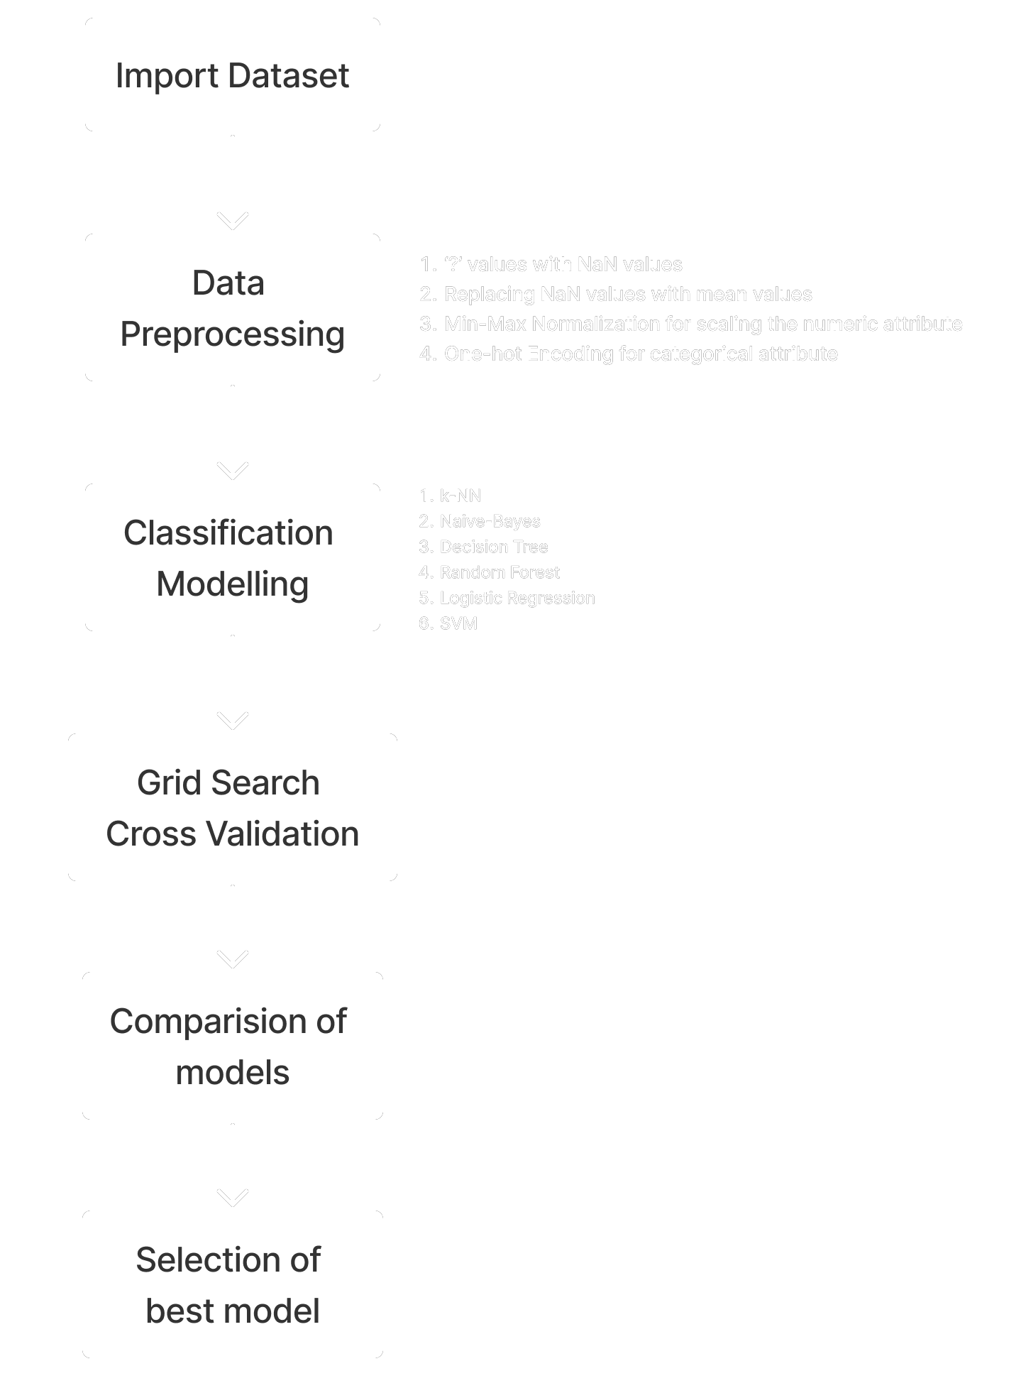
Methodology Flowchart

Slide 6
Data Preprocessing
Replace missing values denoted as "?" with NaN values.
Normalize numeric attributes to have a common scale.
One-hot encode categorical attributes to convert them into numeric values.
Replace NaN values with the mean value of the respective feature.
The processed dataset is now ready for applying machine learning algorithms, enabling us to build models and gain insights and predictions from the data.

Slide 7
Modelling
The cleaned data is split into 80% training and 20% testing sets using train test split(). Six classification algorithms were used: k-NN, Naive-bayes, Decision Trees, Random Forest, Logistic Regression, and SVM. The models were evaluated based on accuracy, f1 score, and a confusion matrix.
KNN is a lazy-learning algorithm that sorts data points into groups based on similarity.
Naive Bayes is a probabilistic classifier that assumes feature independence.
Decision Trees recursively split data based on feature information gain.
Random Forest improves accuracy with an average of decision tree votes.
Logistic Regression estimates the probability of a binary outcome.
SVM finds the best hyperplane to separate data points.

Slide 8
Hyperparameter tuning
Grid Search Cross Validation is a technique used to optimize the performance of machine learning models. It involves systematically testing different combinations of hyperparameters for a given model. A grid of hyperparameters is created and cross-validation is used to evaluate the performance of each combination. This allows for a thorough exploration of the hyperparameter space to find the optimal values. It is an effective technique for finding the best combination of hyperparameters. However, it is computationally expensive, especially for models with many hyperparameters or large datasets. Despite this, it can significantly improve the performance of machine learning models.

Slide 9
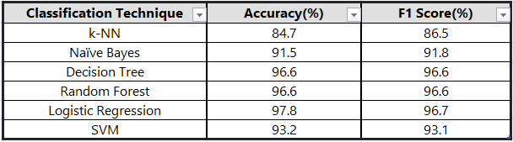
Result and Analysis
The performance of different classification models on an autism spectrum disorder dataset was evaluated by comparing their accuracy and f1 score after hyperparameter optimization. The Logistic Regression classifier achieved the highest accuracy of 97.8% and f1 score of 96.7%, indicating its effectiveness in accurately classifying the dataset. The results highlight the importance of selecting appropriate machine learning models and optimizing their hyperparameters for achieving optimal performance on a given dataset.

Slide 10
Conclusion and Future Work
The present study demonstrates the potential of machine learning in predicting Autism Spectrum Disorder using various classification algorithms and hyperparameter optimization techniques. The study showed that the Logistic Regression classifier outperformed all other models with high accuracy and f1 scores. Future research could explore the use of deep learning techniques, including CNNs, and the incorporation of other types of data, such as images and videos, to enhance the accuracy of the models. Expanding the study to a larger sample size, exploring different feature selection methods, and incorporating more advanced machine learning algorithms, such as neural networks and ensemble methods, could also provide additional insights and improve the accuracy of the classification models. Finally, applying the developed models to real-world scenarios and assessing their practicality and effectiveness could be a valuable area of research.

